Slide 1
Shared Preferences
Musadaq Mansoor
(Credits to Google developers Training)

Slide 2
Android Files
Persistence is a strategy that allows the reusing of volatile objects and other data items by storing them Into a permanent storage system such as disk files and databases.
File IO management in Android includes –among others- the familiar IO Java classes: Streams, Scanner, PrintWriter, and so on.
Permanent files can be stored internally in the device’s main memory (usually small, but not volatile) or externally in the much larger SD card.
Files stored in the device’s memory, share space with other application’s resources such as code, icons, pictures, music, etc. Internal files are called: Resource Files or Embedded Files.

Slide 3
Storage
1. Shared Preferences Store private primitive data in key-value pairs. 2. Internal Storage Store private data on the device’s main memory. 3. External Storage Store public data on the shared external storage. 4. SQLite Databases Store structured data in a private/public database. 5. Network Connection Store data on the web.

Slide 4
Shared Preferences
SharedPreferences files are good for handling a handful of Items. Data in this type of container is saved as <Key, Value> pairs where the key is a string and its associated value must be a primitive data type.
This class is functionally similar to Java Maps, however; unlike Maps they are permanent.
Data is stored in the device’s internal main memory.
PREFERENCES are typically used to keep state information and shared data among several activities of an application.

Slide 5

Shared Preferences

Slide 6
Using Preferences API calls
Each of the Preference mutator methods carries a typed-value content that can be manipulated by an editor that allows putXxx… and getXxx… commands to place data in and out of the Preference container. Xxx = { Long, Int, Double, Boolean, String }

Slide 7
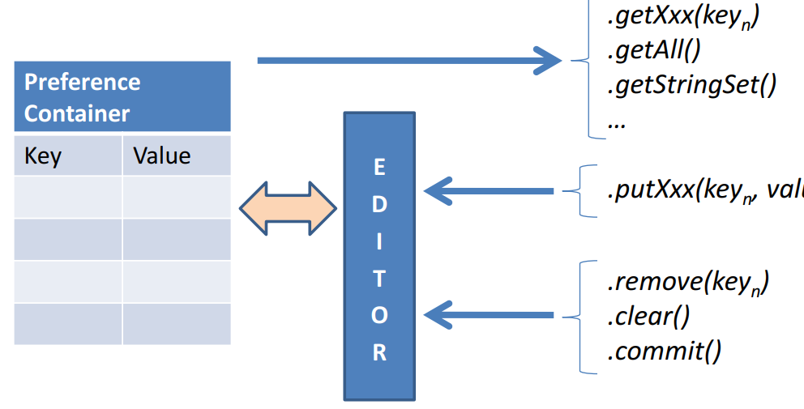

Slide 8
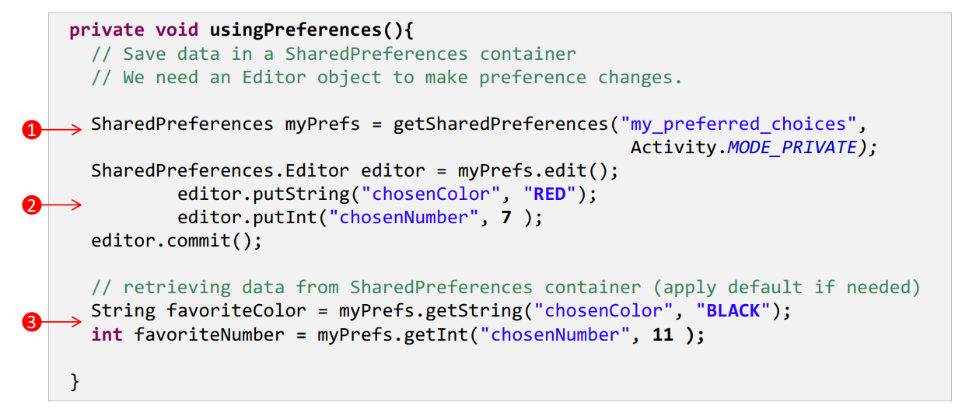

Slide 9
Details
The method getSharedPreferences(…) creates (or retrieves) a table called my_preferred_choices file, using the default MODE_PRIVATE access. Under this access mode only the calling application can operate on the file
A SharedPreferences editor is needed to make any changes on the file. For instance editor.putString("chosenColor", "RED") creates(or updates) the key “chosenColor” and assigns to it the value “RED”. All editing actions must be explicitly committed for the file to be updated.

Slide 10
Details
The method getXXX(…) is used to extract a value for a given key. If no key exists for the supplied name, the method uses the designated default value. For instance myPrefs.getString("chosenColor", "BLACK") looks into the file myPrefs for the key “chosenColor” to returns its value, however if the key is not found it returns the default value “BLACK”.

Slide 11
File
SharedPreference containers are saved as XML files in the application’s internal memory space. The path to a preference files is /data/data/packageName/shared_prefs/filename.

Slide 12
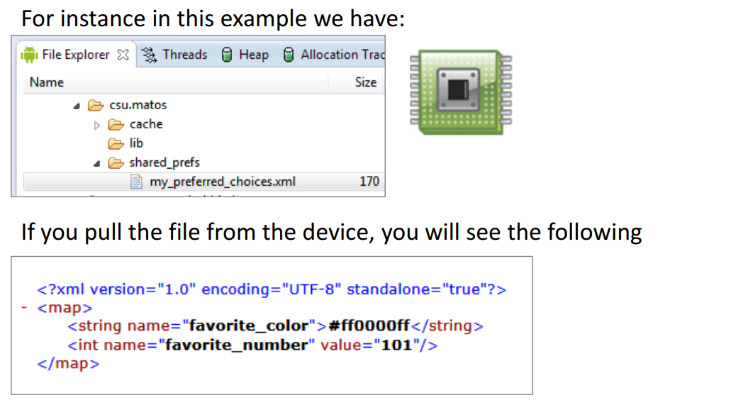

Slide 13
Thanks
Any Questions?

